Slide 1
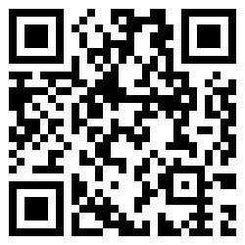
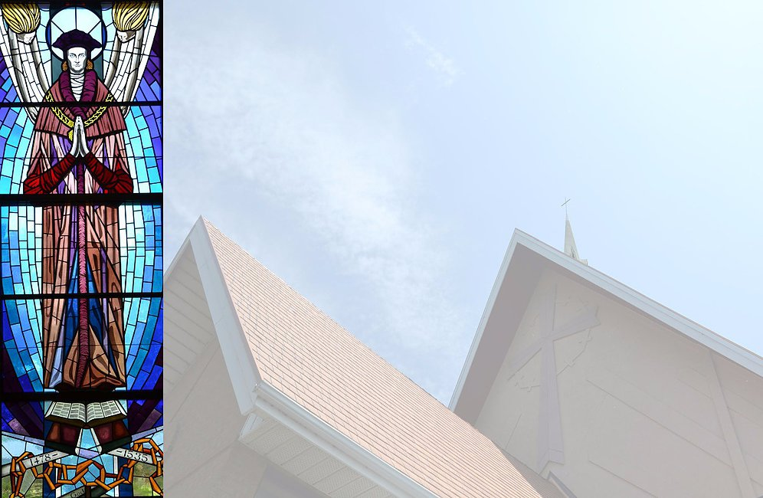
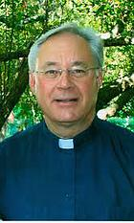
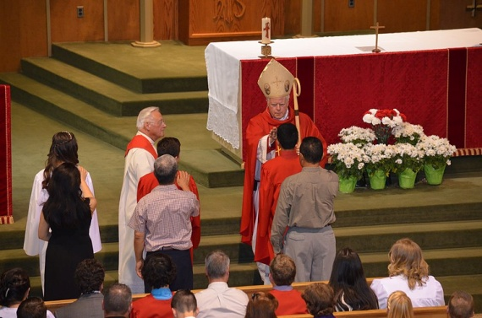
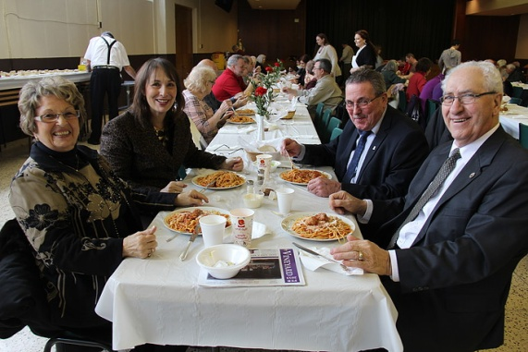
Visit your St. Thomas More Website often at stthomasmorecatholicchurch.com
Contact the Parish
Mass Times
Photos
Bulletins & Calendars
Parish Events
Sacraments
Confession Times
Parish Groups
Parish History
Catholic News Agency
Pope Francis Today
Daily Year of Mercy
Refugee Family Sponsorship
Ministries
Holy Hour Times
Ministry Schedules
Resources
And more ...

