Slide 2
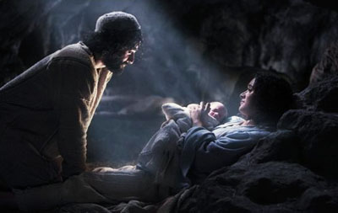
Response
The Word was made flesh and dwelt among us.

Slide 3
O Word made flesh, you came to dwell among us long ago. No matter how dull and lifeless, or how happy and fulfilling our lives may be, there is always need for a deeper awareness of your hopeful presence. There are signs of your coming, signs of your continued presence, everywhere in our lives. Freshen up our vision so that we can recognize your dwelling within us and among us as we move hurriedly in this busy season of the year. And may our lives be filled with love for all those who come our way. Amen.

