Slide 1
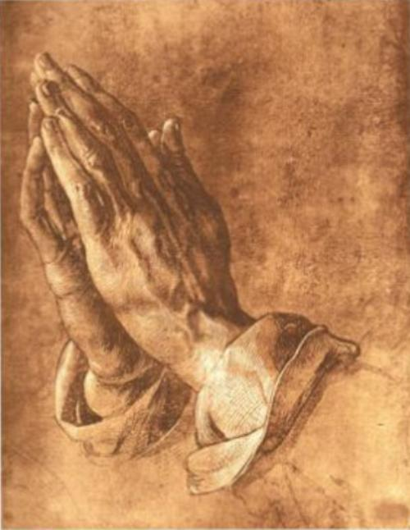
Know Him Through Prayer

Slide 6
Glory Be
Glory be to the Father, and to the Son, and to the Holy Spirit; as it was in the beginning, is now, and ever shall be, world without end.
Amen.

Slide 7
Amen.

