Slide 1
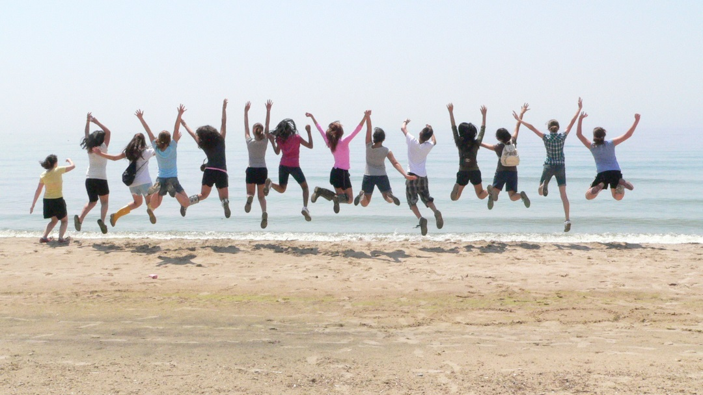
Staff Faith Formation and Prayer….BE Blessed!
June 2016

Slide 2
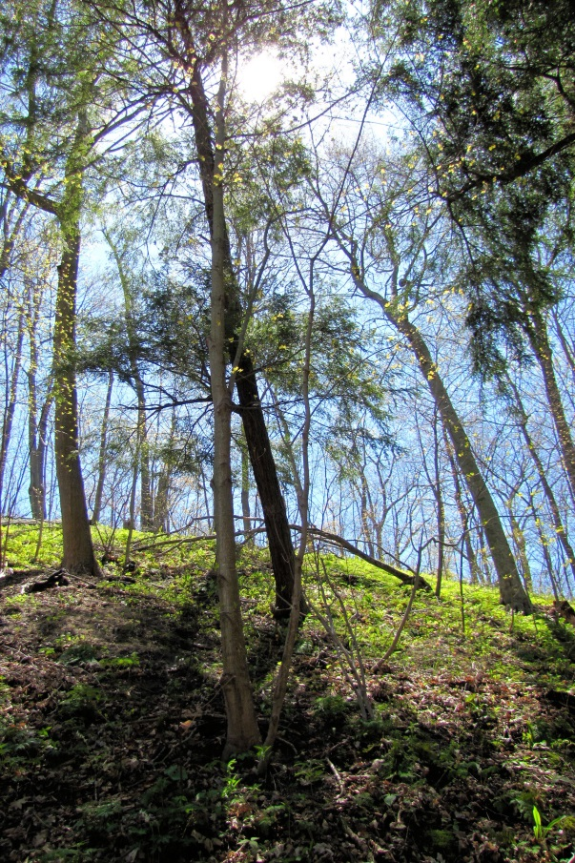
Summer = Ordinary Time

Slide 3
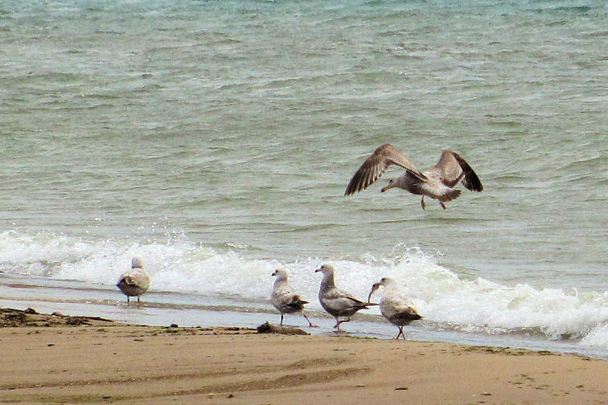
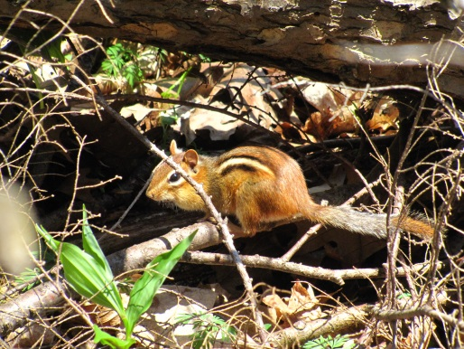

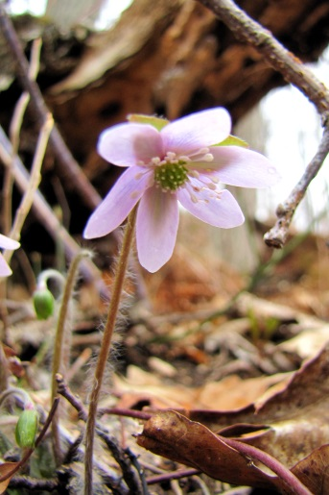

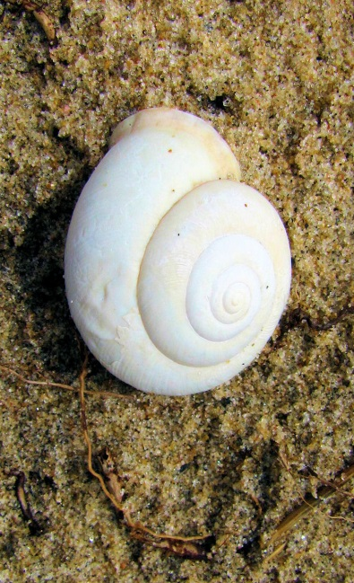


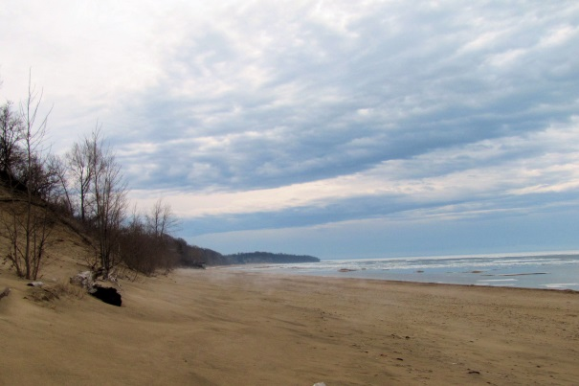
Images of Summer
Marcy Woods, a Journey Day Excursion

Slide 4
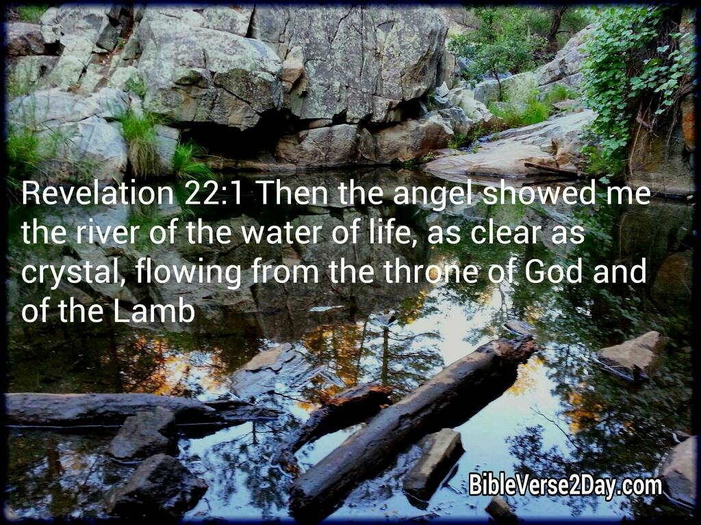
Revelation: 22

Slide 5

Personal Reflection:
Gifts, Talents, Successes

Slide 6
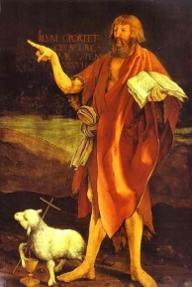
St. John the Baptist

Slide 7
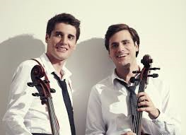
Benedictus – Canticle of Zechariah
https://www.youtube.com/watch?v=f_RjlIPuqyc
2Cellos Live @ Arena Zagreb (2013)
Creed for the Gentle
Notes:
And do not underestimate the importance of being fulfilled,
for if you are not whole in your satisfaction,
you cannot wholly give it to others.
Step forward to another day,
taking with you the best of the last and the lessons learned.
But remember, even when we are dissatisfied with ourselves,
there is One who knows us completely and will not desert us.
Take courage to live at a slower pace
and to listen to the self you have yet to discover.

Slide 8
Creed for the Gentle
In your laughter, let there be happiness,
in your tears, renewal.
In your quiet moments, contentment,
in your dreams, a future promise.
Let there be peace in your time alone and friendship in a crowd.
Let your knowledge of yourself bring you
to a greater understanding of what you can achieve.
Do not place too great a value on material world, but take time
to listen to the ballad of the birds in green valleys
Hurry not from one workload to another
without taking time to be aware of your own needs
and the needs of others.
Notes:
In your laughter, let there be happiness,
in your tears, renewal.
In your quiet moments, contentment,
in your dreams, a future promise.
Let there be peace in your time alone and friendship in a crowd.
Let your knowledge of yourself bring you
to a greater understanding of what you can achieve.
Do not place too great a value on material world, but take time
to listen to the ballad of the birds in green valleys
Hurry not from one workload to another
without taking time to be aware of your own needs
and the needs of others.
In your laughter, let there be happiness,
in your tears, renewal.
In your quiet moments, contentment,
in your dreams, a future promise.
Let there be peace in your time alone and friendship in a crowd.
Let your knowledge of yourself bring you
to a greater understanding of what you can achieve.
Do not place too great a value on material world, but take time
to listen to the ballad of the birds in green valleys
Hurry not from one workload to another
without taking time to be aware of your own needs
and the needs of others.

Slide 9
And do not underestimate the importance of being fulfilled,
for if you are not whole in your satisfaction,
you cannot wholly give it to others.
Step forward to another day,
taking with you the best of the last and the lessons learned.
But remember, even when we are dissatisfied with ourselves,
there is One who knows us completely and will not desert us.
Take courage to live at a slower pace
and to listen to the self you have yet to discover.

Slide 10

THIS Summer…
Be blessed.
Be at peace.
Please share a sign of peace
with those around you.

