Slide 2
Let us protect Christ in our lives, so that we can protect others, so that we can protect creation!
Pope Francis Homily at His Inauguration

Slide 3
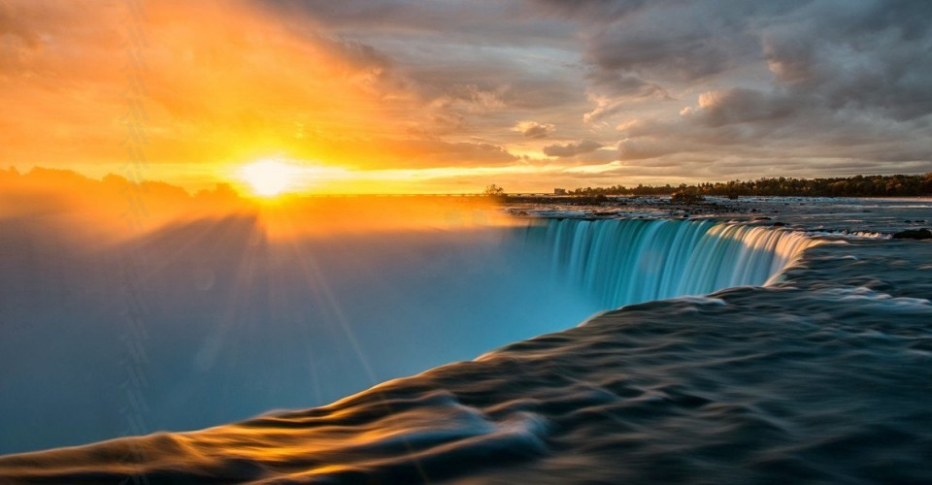
OPENING PRAYER
Leader: Blessed be God, Creator, Word and Spirit;
All: Who brings all things into being and calls them good.
Leader: Bless your Creator, all children of God.
All: Let us praise and exalt our Creator together.
Leader: Bless your Creator, all birds of the air.
All: Let us praise and exalt our Creator together.
Leader: Bless your Creator, all creatures of the sea.
All: Let us praise and exalt our Creator together.
Leader: Bless your Creator all animals of the land.
All: Let us praise and exalt our Creator together.
Leader: Creator God, grant us your grace, that we may
always respect your whole creation with great joy.
All: Amen.

Slide 4
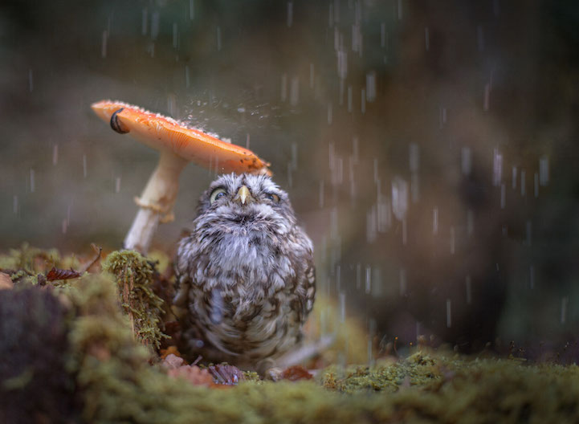

Slide 5
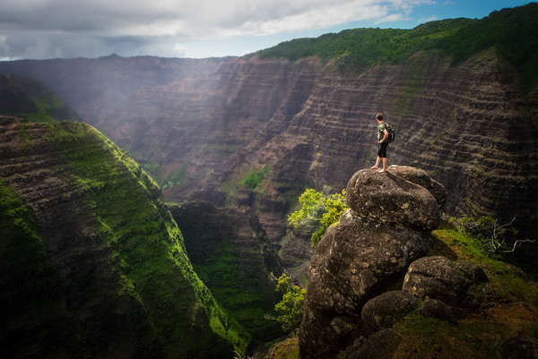
Closing Prayer
Let us live without fear: for our Creator has made us holy, has always protected us, and loves us. In God’s peace let us always respect one another and all God’s creation . May God bless us always. Amen †

