Slide 1


Educators’ Resource Guide
Assessment OF Learning
(Chapter 3)
Research, Assessment and Evaluation Department
Lee Ann Forsyth-Sells, Superintendent of Education
Anthony Corapi, Consultant

Slide 2
Assessment OF learning refers to those assessments – oral, performance, and written, as well as assessments combining two or more of these modes – that occur at or near the end of an instructional unit, term, or semester.
- Damian Cooper

Slide 3
The marks, scores and achievement levels that students receive on these assessments OF learning are used to generate report card grades.
Report card grades must not include data gathered from assessments FOR learning since these assessments represent students’ early attempts…
- Damian Cooper

Slide 4
Effective Practices
To ensure valid and fair assessment OF student learning, follow these guidelines:
Gather evidence (write/do/say) to determine grades within the appropriate categories.
Gather evidence using a variety of assessment strategies so that all students can demonstrate learning.
Allow student choice within assessment tasks to address individual needs.
Provide timely descriptive feedback.

Slide 5
Effective Practices
Use professional judgment to review a student’s learning over time (most consistent, more recent levels of evidence gathered)
Use numerous and varied opportunities to contribute to the concept of most consistent.
Review inconsistencies in performance to determine the reason for the occurrence.
Use recent evidence when looking for growth over time.
It is inappropriate to average student marks to determine an overall level of achievement.

Slide 6
Professional Judgment
The knowledge and skills teachers use to make informed decisions about student performance in relationship to the expectations and achievement categories.
  How can I justify the grades/marks I have given?
  Have I examined evidence that is consistent over the reporting period with consideration of more recent evidence , when applicable?
  Is there sufficient balance among the categories?

Slide 7
Academic Integrity
As with most behavioural concerns, there are two main issues: how to prevent it and what to do about it when it happens. “If teachers focus on proactive strategies in their assessment practices, then there will be fewer situations where behavioural consequences are necessary.”
- Ken O’Connor

Slide 8
Missed Task and Teacher Response
Student does not complete task by due date
Student Reminders
Inform Parents and Seek Support
Record “incomplete”
Student Reminders
Alternative Task(s)
Additional Support
Parent Communication
Student does not complete task by end-of-unit date
Student does not complete task by the end of the term/semester/year
Sufficient Evidence?
Determine Grade (use professional Judgment)
Note in Learning Skills
“R” or Failing Grade
Credit Recovery

Slide 9
Defining Tools and Strategies
Assessment Tools
(use assessment tools to record the assessment information gathered using various strategies)
Anecdotal Records
Assessment Strategies
(use assessment strategies to assess student performance and progress)
Observation
Analysis of Student Work
Rating Scales
Checklists
Rubrics
Responses (written and Oral)
Conference with Students

Slide 10
The teacher will consider all evidence collected through observations, conversations, and student products.
The teacher will consider that some evidence carries greater weight than other evidence; for example, some performance tasks are richer and reveal more about students’ skills and knowledge than others.
- Growing Success (p.39)

Slide 11
The following slides provide examples of tools, strategies, and tasks that teachers may use to collect evidence of student achievement.

Slide 12
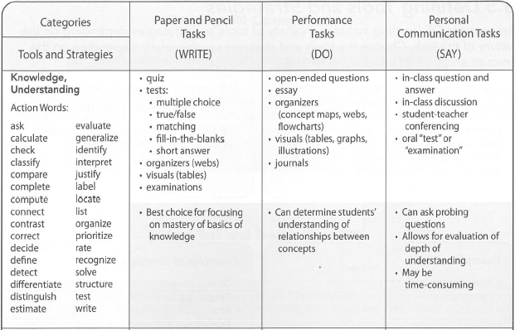
Write…Do…Say

Slide 13
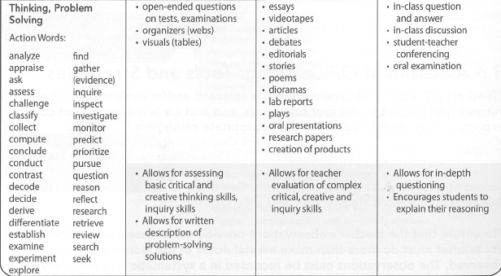
Write…Do…Say

Slide 14
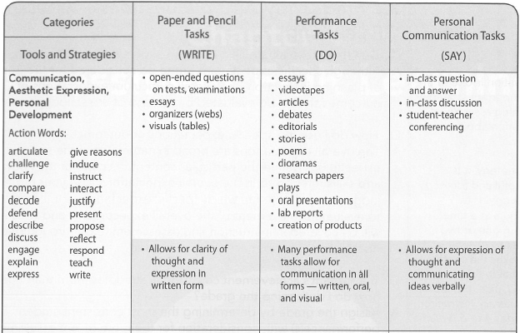
Write…Do…Say

Slide 15
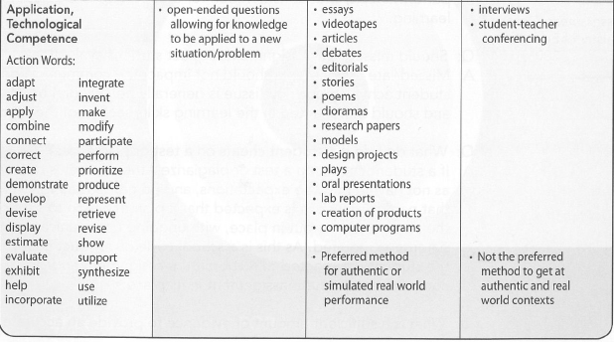
Write…Do…Say

Slide 16
Observation is one of the most important strategies for gaining assessment information about a student.
As a strategy it is purposeful and focused on only one or two behaviours at a time.
Selecting one or two students to observe at a time makes this strategy manageable.
- Ontario Ministry of Education

Slide 17
Exemplars
Samples of student work that reflect different levels of quality.
Rubrics and exemplars used together help students better understand what quality looks like.
Effective way of defining quality to students
Works of DIFFERENT QUALITY and DESCRIPTORS are connected

Slide 18
Please review the FREQUENTLY ASKED QUESTIONS at the end of each chapter.

