Slide 1


Educators’ Resource Guide Overview
(Chapters 1-2)
Research, Assessment and Evaluation Department
Lee Ann Forsyth-Sells, Superintendent of Education
Anthony Corapi, Consultant

Slide 2
The greatest challenge we face once we demand that all students demonstrate proficiency on the essential learning for a given subject and grade is time.
For teachers to differentiate instruction and assessment to meet the strengths and needs of students they must engage in the long-range planning process of backward design to determine what is essential in learning.
With curriculum documents and classroom resources at hand, they must agree on the essential concepts and skills that students must acquire and demonstrate by the end of the term, semester, or year.
- Cooper, 2011

Slide 3

Purpose: Educators’ Resource Guide
Provide educators with guidelines an/or direction for assessment, evaluation and communication of student achievement (AEC)
Engage educators in professional learning and dialogue with respect to best practice in assessment, evaluation, and communication of student achievement
Cite links to relevant policy and procedure regarding assessment, evaluation, and communication of student achievement

Slide 4
Seven Guiding Principles of AEC
Teachers use practices and procedures that..
are fair, transparent and equitable for all students.
support all students (Special Needs, FNMI)
are carefully planned to relate to the curriculum expectations and learning goals.
are communicated clearly to students, parents/guardians throughout the year.
are ongoing, varied in nature and administered over a period of time to provide multiple opportunities for students to demonstrate learning.
provide ongoing descriptive feedback that is clear and meaningful.
develop students’ self assessment skills and set specific goals and plan next steps.

Slide 5
For assessment to be helpful to students, it must inform them in words, not numerical scores of letter grades, what they have done well, what they have done poorly, and what they need to do next in order to improve.
- Cooper, 2007

Slide 6
THE BACKWARD DESIGN MODEL

Slide 7
The Backward Design Model
Identify desired results
Determine acceptable evidence
Plan learning experiences and instruction

Slide 8
Managing the Curriculum
Starting with Overall Expectations
  BIG IDEAS
  Assessment OF Learning
Specific Expectations
  day-to-day lessons and embedded in smaller assessment tasks
  Building Blocks of culminating, end-of-unit assessments

Slide 9
Identify desired results
Determine acceptable evidence
Plan learning experiences and instruction
Overall
Expectations
Culminating Tasks
(OF)
Enabling Tasks
(FOR)
Specific
Expectations

Slide 10
Identify desired results
What should students know, understand, and be able to do? What do they already know?
How will you know if students have achieved the desired results and expectations? What will you accept as evidence of understanding and proficiency?
Determine acceptable evidence
What knowledge and skills will students need to perform effectively and achieve desired results?
Prior knowledge and experience?
What activities will equip students with the needed knowledge and skills?
What will you need to teach and coach with respect to LG/SC?
Materials and Resources?
Is the overall design coherent and effective?
Plan learning experiences and instruction

Slide 11
LEARNING SKILLS

Slide 12
Learning Skills
Accuracy and Useful
  Teachers need to plan how they are going to gather data and track
Teachers need to attach one or more of the LS/WH to each assessment task
Example: Working in a group for a task (collaboration)
Resources:
  http://www.misalondon.ca/ae_01.html
  http://www.misalondon.ca/ae_03.html
  Educators’ Resource Guide (LS Rubric)

Slide 13
HOW they learn
WHAT they earn
Learning Skills
Expectations
Examples:
IW, I, R, O, C, SR
Determine how well students measure up to the provincial expectations
Evaluate learning skills
Apply to categories
Achievement of Expectations determines marks

Slide 14
Resources
Educators’ Resource
  P, VP and Chair
Secondary and Elementary Specific Guides
  Backwards Design Templates
  Sample Units
  Classroom Strategies
  London MISA Resources (FOR, AS, OF)
  http://www.misalondon.ca/ae_04.html
  EduGains (AER Gains section)
  http://www.edugains.ca/newsite/index.html

Slide 15
DIFFERENTIATED INSTRUCTION

Slide 16
Differentiated Instruction
(DI)
To differentiate instruction is to recognize students’ varying levels of background knowledge, readiness to learn, language ability, learning preferences, and interests, and to react responsively.
(Hall, Strangman, & Meyer, 2003)

Slide 17
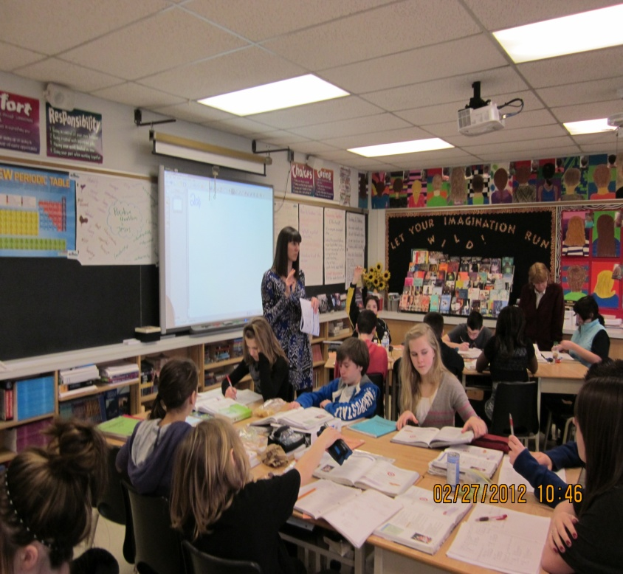
Differentiated Instruction
Students differ in their strengths, interests, learning style and readiness to learn.
Instruction must be adapted to suit these differing characteristics.
Elements to consider differentiating:
  Content of learning
  (what and when to learn).
  Process of learning (types of tasks/activities).
  Products of learning (ways to demonstrate).
  Affect/environment of learning (context and environment).

Slide 18
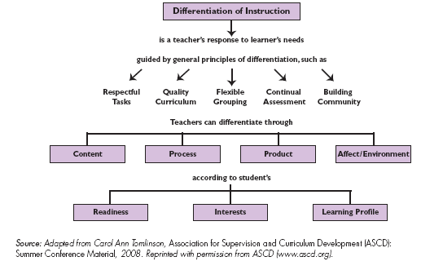
Concept Map of Differentiated Instruction

Slide 19
RUBRICS

Slide 20
Rubrics
Instructional tool used to measure student achievement
Purpose is to improve and guide student learning
Exemplars accompany effective rubrics
Based on criterion-referenced standards
Ensure accountability for student achievement of the expectations

Slide 21
Why Use Rubrics?
TEACHER PERSEPCTIVE
Are instructional tools
Can be used for diagnostic, formative and summative assessments
Provide the criteria of quality work at various levels of performance
Provide informative feedback about strengths, areas of improvement, and next steps
Facilitate collaborative planning and assessment
STUDENT PERSPECTIVE
Clearly identify the learning target
Outline the criteria of quality work at various levels of performance
Help students spot and address strengths and weaknesses in their own work and the work of others
Provide informative feedback about strengths, areas for improvement, and next steps

Slide 22
Educators’ Resource Guide Overview
(Chapter 3)
Assessment OF Learning
Research, Assessment and Evaluation Department
Lee Ann Forsyth-Sells
Anthony Corapi

