Slide 1


Educators’ Resource Guide
Supporting English Language Learners and Students with Special/Exceptional Needs
(Chapter 7)
Research, Assessment and Evaluation Department
Lee Ann Forsyth-Sells, Superintendent of Education
Anthony Corapi, Consultant
1

Slide 2
Part 1:
English Language Learners

Slide 3
“ELLs bring a wealth of knowledge and experience that when tapped, enriches the knowledge and understanding of all learners in the classroom.”
-Supporting English Language Learners. A Practical Guide for Ontario Educators (Grades 1 to 8). Ontario Ministry of Education, 2008

Slide 4
English Language Learners
ELLs are students in English-language schools whose first language is a language other than English or is a variety of English that is significantly different from the variety used in instruction.
May be Canadian-born or from another country
Diverse background
Variety of strengths and needs
Aboriginal students whose first language is not English
Children born in distinct cultural or immigrant communities

Slide 5
Programming for ELLs
Programs may be adapted to align instruction and assessment with student’s stage of development in English.
Adaptations
Include modifications and accommodations
Modifications
Adjustments to the number and/or complexity of the curriculum expectations
Accommodations
Strategies and provisions by teacher to help student meet the curriculum expectations

Slide 6
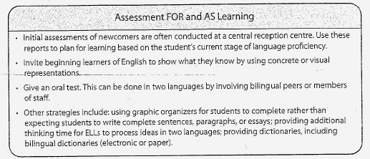
Considerations for Assessment, Evaluation and Communication of Achievement of ELLs

Slide 7
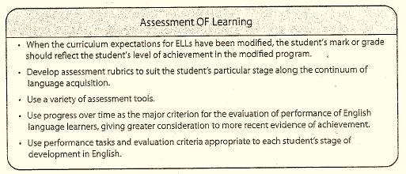
Considerations for Assessment, Evaluation and Communication of Achievement of ELLs

Slide 8
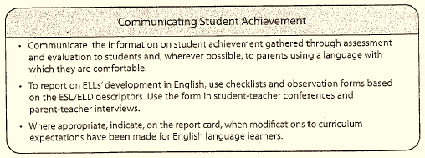
Considerations for Assessment, Evaluation and Communication of Achievement of ELLs

Slide 9
Part 2:
Students with Special/Exceptional Needs

Slide 10
Special Education Programs
Individualized Education Plans (IEP)are designed to provide students with an educational plan based on their needs.
Programs can include:
  Additional or alternate curriculum
  Accommodations
  Adaptations
  Individualization
  Modifications
  Changes to teaching technology
  Evaluation
  Support from school staff

Slide 11
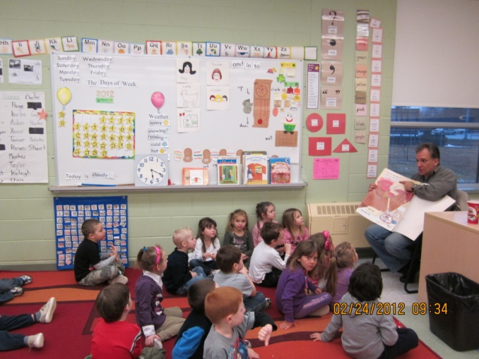

Universal Design for Learning and Differentiated Instruction
Used in combination, UDL and DI enable teachers to respond effectively to the strengths and needs of all students.
UDL provides teachers with broad principles for planning instruction for a diverse group of students.
DI allows teachers to address specific skills and difficulties.

Slide 12
Programming for Students with
Special/Exceptional Needs
Universal Design for Learning (UDL)
“Universal Design is not just a technique for special education; rather it is a
technique to enhance the learning for all students.”
(Turnbull, Turnbull, Shank, Smith, & Leal, 2002, p.92)
“In a diverse classroom, no single method can reach all learners. Multiple
pathways to achieving goals are needed.”
(Hitchcock, Myer, Rose, & Jackson, 2002, p. 18)

Slide 13
Differentiated Instruction (DI)
To differentiate instruction is to recognize students’ varying levels of background knowledge, readiness to learn, language ability, learning preferences, and interests, and to react responsively.
(Adapted from Hall, Strangman, & Meyer, 2003, pp.2-3)

Slide 14

Differentiated Instruction
Students differ in their strengths, interests, learning style and readiness to learn.
Instruction must be adapted to suit these differing characteristics.
Elements to consider differentiating:
  Content of learning
  (what and when to learn).
  Process of learning (types of tasks/activities).
  Products of learning (ways to demonstrate).
  Affect/environment of learning (context and environment).

Slide 15
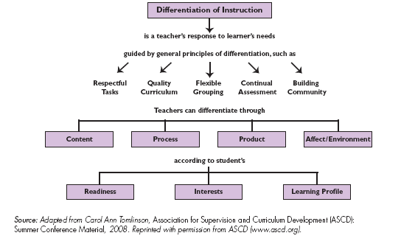
Concept Map of Differentiated Instruction

Slide 16
Tiered Approach
A tiered approach is an effective process to assessment and evaluation that sequentially increases the intensity of instruction and intervention.

Slide 17
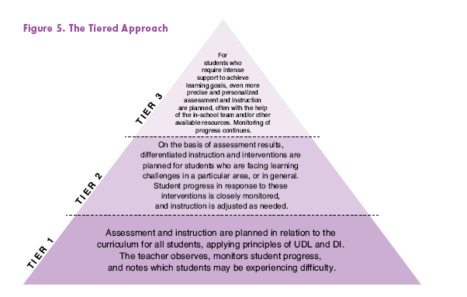
The Tiered Approach

Slide 18
Tier One
Is classroom based
Begins with creating a class or individual profiles
Involves planning DI and assessment, including informal collaboration with other members of school staff
Gathers information from parents
Monitors students progress

Slide 19
Tier Two
FOR STUDENTS NOT SUCCESSFUL AT TIER ONE…
Is classroom based.
Involves more intensive instruction along with Tier One instruction.
Requires ongoing SBT meetings with staff to problem solve and determine programming based on data.

Slide 20
Tier Three
FOR STUDENTS NOT SUCCESSFUL AT TIER ONE AND TWO…
Involves more in-depth assessment (psycho-educational)
Includes specialized instruction
Includes a variety of personnel

Slide 21
Considerations for Assessment, Evaluation and Communication of Achievement of Students with Special Needs
Assessment is an ongoing process.
Teachers use a variety of methods to gather information on student achievement, level of understanding and the effectiveness of strategies.
Methods: observations, conferences and criterion-referenced performance tasks..
Information and data collected is used primarily for planning programs to meet each student’s strengths, interests, needs, and level of functioning.

Slide 22
Accommodations, Modifications and Alternative Expectations
Accommodations | Modifications | Alternative Expectations
No change to curricular expectations. Grades/marks reflect the student’s achievement of grade-level expectations. No reference to the accommodations appears in the comments. | The modified curriculum expectations are described in the IEP. Grades/marks reflect the student’s achievement of expectations in the IEP. | Expectations are not reflected in the curriculum. The specific expectations developed for the student are described in the IEP. An alternative report is completed with anecdotal comments regarding the student’s achievement of alternative expectations in the IEP.

Slide 23
Frequently Asked Questions
Q: How can I modify the curriculum?
You can modify the curriculum by increasing and/or reducing the number and/or complexity of the curriculum expectations from the regular grade level.
You can develop expectations that reflect the knowledge and skills required in the curriculum for a different grade level to meet students learning needs, allow further learning growth, and maximize student achievement.

Slide 24
Frequently Asked Questions
Q: How do I assess and evaluate a student with an IEP?
Evaluate student progress in relation to the curriculum expectations as outlined on the individual plan.
Review each student’s plan on a regular basis to determine whether or not the goals/objectives need to be revised to better meet the needs of the student.

Slide 25
Frequently Asked Questions
Q: How do I determine which grade level expectations are appropriate for a student requiring curriculum modifications?
To determine the appropriate grade level expectations, review the previous student plan.
Conduct assessments on a regular basis to ensure the grade level expectations are appropriate.

Slide 26
Frequently Asked Questions
Q: How do I know what my students’ needs are?
It is important to get to know your students at the start of the school year by assessing their readiness, interests, learning styles, and/or multiple intelligences.
It is important to review student records (IEPs), student plans, past report cards and other relevant information.
Consultation with former teachers is also key to determining needs.

