Slide 1
7.05pm Wednesday 13th 2013

Slide 2
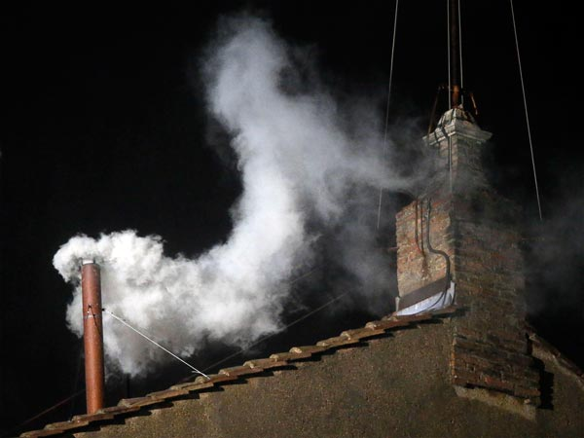
http://www.youtube.com/watch?v=q04URbhvYdo

Slide 3
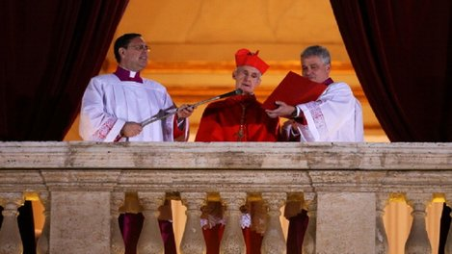
French Cardinal Jean-Louis Tauran announced the newly elected Pope as Pope Francis on the central balcony of St Peter's Basilica. Argentinian Cardinal Jorge Mario Bergoglio was elected as the 266th Pontiff and will lead the world's 1.2 billion Catholics.
http://www.youtube.com/watch?v=HC-9q_E5JFQ

Slide 4
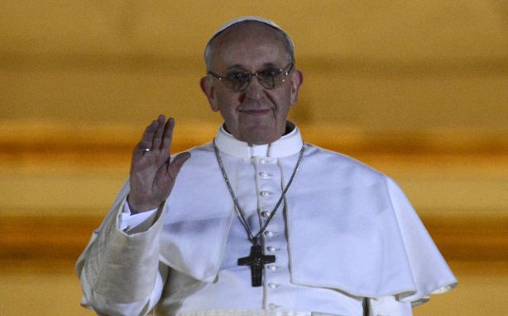
Pope Francis

Slide 5
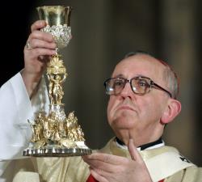
Born: 17 December 1936 in Buenos Aires
Ordained Priest : 13 December 1969 as a Jesuit.
Ordained Bishop: 20 May 1992 as Bishop of Auca and Auxiliary of Buenos Aires.
Ordained Archbishop: 3 June 1997 as Archbishop of Buenos Aires, Argentina.
Ordained Cardinal: 21 February 2001 by Bl. John Paul II.

Slide 6
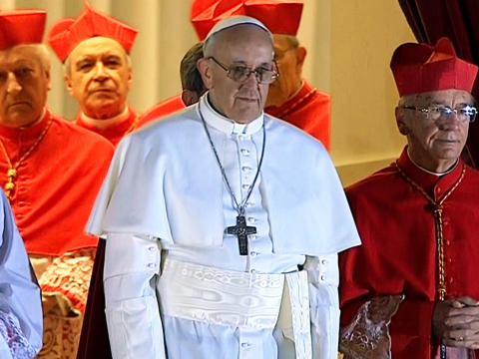
1st
Francis
American (N or S)
Jesuit
Non-European in over 1000 years

Slide 7
What is a Jesuit?
A member of the Society of Jesus, sometimes called colloquially "God's Marines”.
Founded by Saint Ignatius of Loyola who had a military background and still today members must show a willingness to accept orders anywhere in the world and live in extreme conditions.
Jesuits are known for their work in education, academic research and for their missionary efforts.

Slide 8
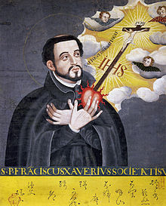
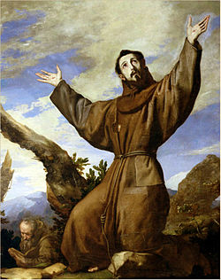
Why Francis?
This may show us three things:
his desire to be a force of unity in a divided Church (Franciscans were seen as ‘rivals to Jesuits)
his heart for the poor
his intent to "repair God's house, which has fallen into ruin"... that is, to rebuild the church.
Above: St Francis Xavier SJ
Below: St Francis of Assisi

Slide 9
Life as Cardinal in Argentina
He chose to live in a simple apartment rather than the archbishop's palace.
He gave up his chauffeured limousine in favour of taking the bus to work.
He cooks his own meals.
He flies economy class to Rome.
He's known locally simply as "Fr Jorge.“
He told Argentinians not to travel to Rome to celebrate if he was appointed but to give their money to the poor instead.

Slide 10
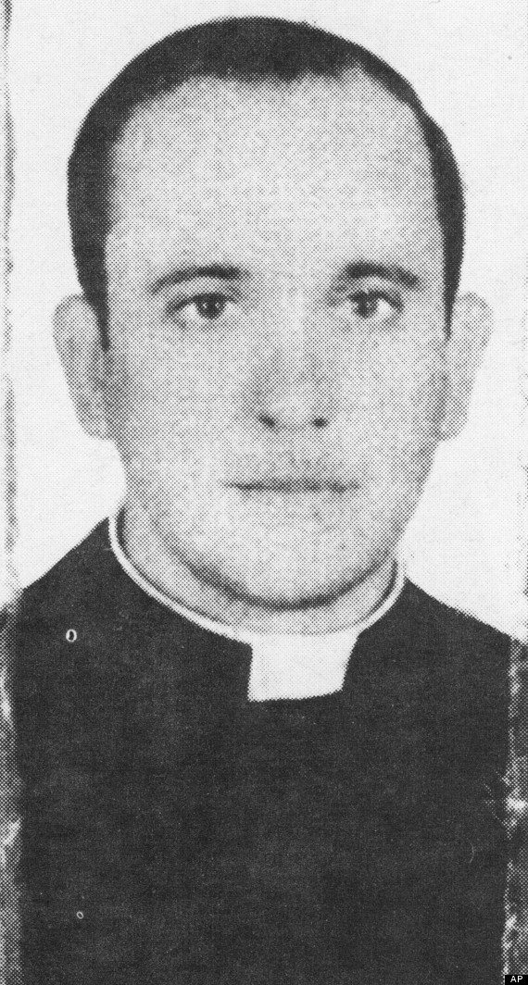
Growing Up
One of the five children of an Italian railway worker and his wife.
Taught literature, psychology and philosophy.
Trained as a chemist.
Had a tough life under the military Junta of Argentina.
Has lived for more than 50 years with one functioning lung. He had the other removed as a young man because of infection.
He speaks fluent Italian, as well as Spanish and German.

Slide 11
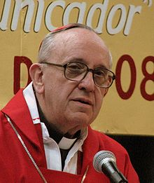
Life in the Church
In 2001 he washed and kissed the feet of Aids patients in a hospice.
Was very close to being elected as Pope in 2005. He was only beaten by Cardinal Ratzinger who went on to be Pope Benedict XVI.
He has co-written a book, in Spanish, called Sobre el Cielo y la Tierra (On Heaven and Earth).
He has criticised priests who refuse to baptise babies born to single mothers.
He believes that condoms "can be permissible" to prevent infection.

Slide 12
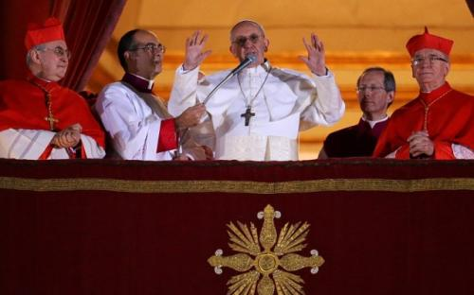
Prayer
The first prayer Pope Francis I lead in the Vatican was the Our Father. A sign of united Christians around the world.

Slide 13
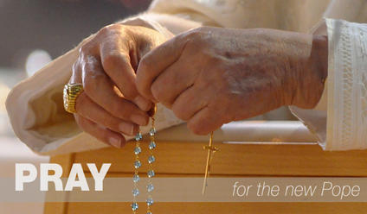
O God, who in your providential design willed that your Church be built upon blessed Peter, whom you set over the other Apostles, look with favour, we pray, on Francis our Pope and grant that he, whom you have made Peter’s successor, may be for your people a visible source and foundation of unity in faith and of communion. Through our Lord Jesus Christ, your Son, who lives and reigns with you in the unity of the Holy Spirit, one God, for ever and ever.
Amen.

