Slide 1
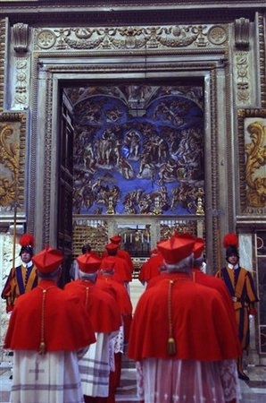
Conclave 2013

Slide 2
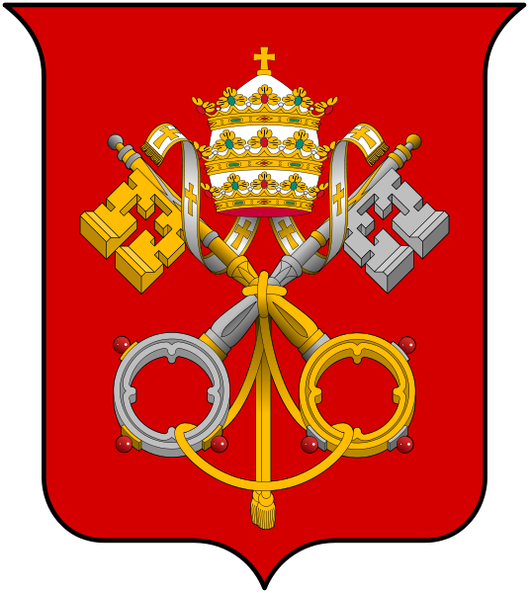
The Holy See
Coat of Arms
Keys - based on Jesus’ promise to St. Peter “I will entrust to you the keys of the kingdom of heaven; whatever you declare bound on earth shall be bound in heaven; whatever you declare loosed on earth shall be loosed in heaven.” Matthew 16:19
Gold Key – power reaches to heaven
Silver key – extends to all the faithful
Tiara – popes no longer wear a tiara, but the three crowns are still a strong heraldic symbol for the Pope’s powers as priest, ruler and teacher

Slide 3
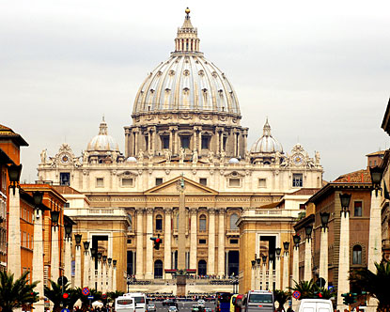
St. Peter’s Basilica
within the Vatican, burial site of St. Peter, the first Pope

Slide 4
Francois Malan
St. Peter’s Basilica from St. Peter’s Square

Slide 5
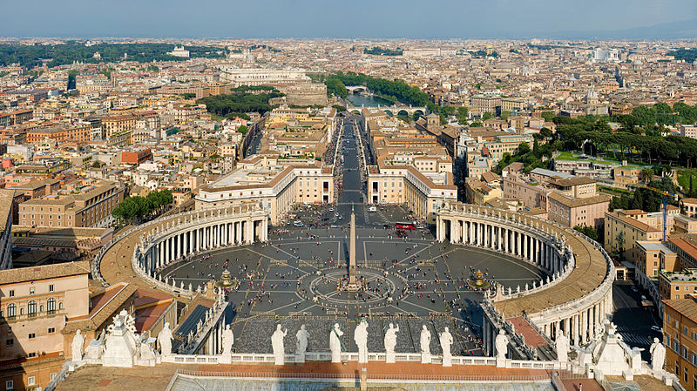
Photo by DAVID ILIFF. License: CC-BY-SA 3.0
City of Rome from the Dome of St. Peter’s Basilica
Note statues of 12 apostles, “Arms of Bernini”(the designer)—the Church embracing the pilgrims of the world gathered in the Square topped by 140 statues of saints and martyrs.

Slide 6
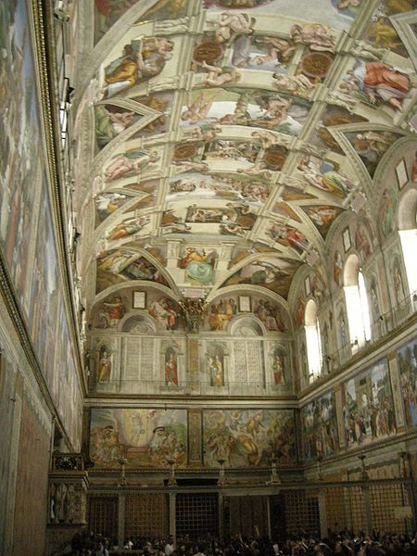
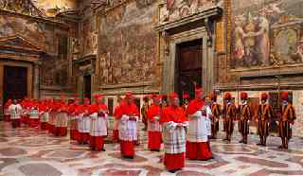
The Sistine Chapel
www.thetimes.co.uk
Cardinals will gather in the Sistine Chapel for all the days of the Conclave.
Artwork from a number of Renaissance artists adorn the walls, along with the famous frescoes painted by Michelangelo between 1508 and 1512. Major restoration of the artwork was undertaken between 1980 and 1994.
I, Sailko

Slide 7
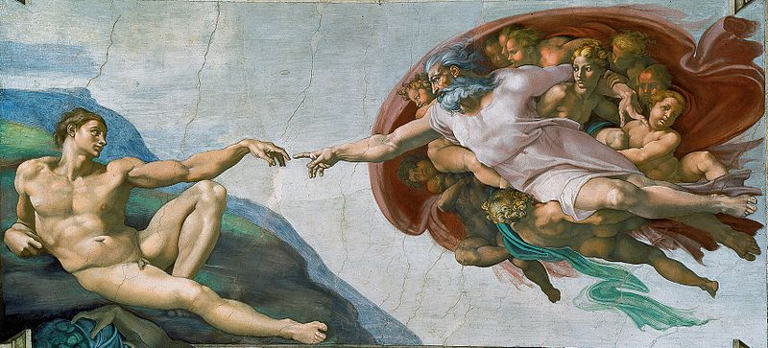
Michelangelo Buonarroti
Creation of Adam
(restored)

Slide 8
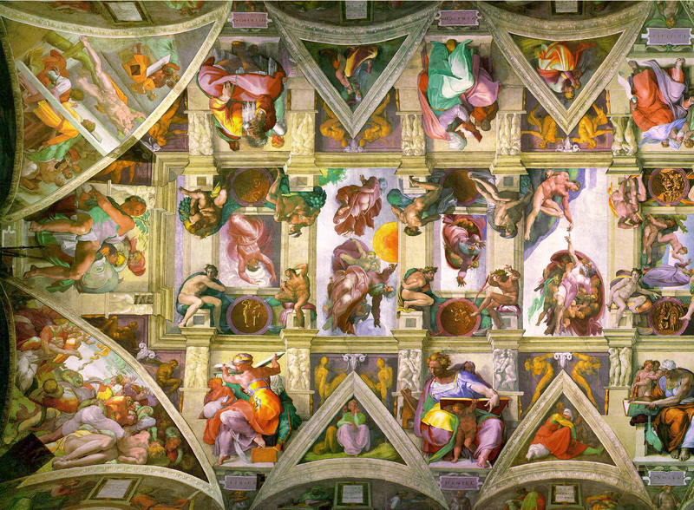
The Ceiling - restored

Slide 9
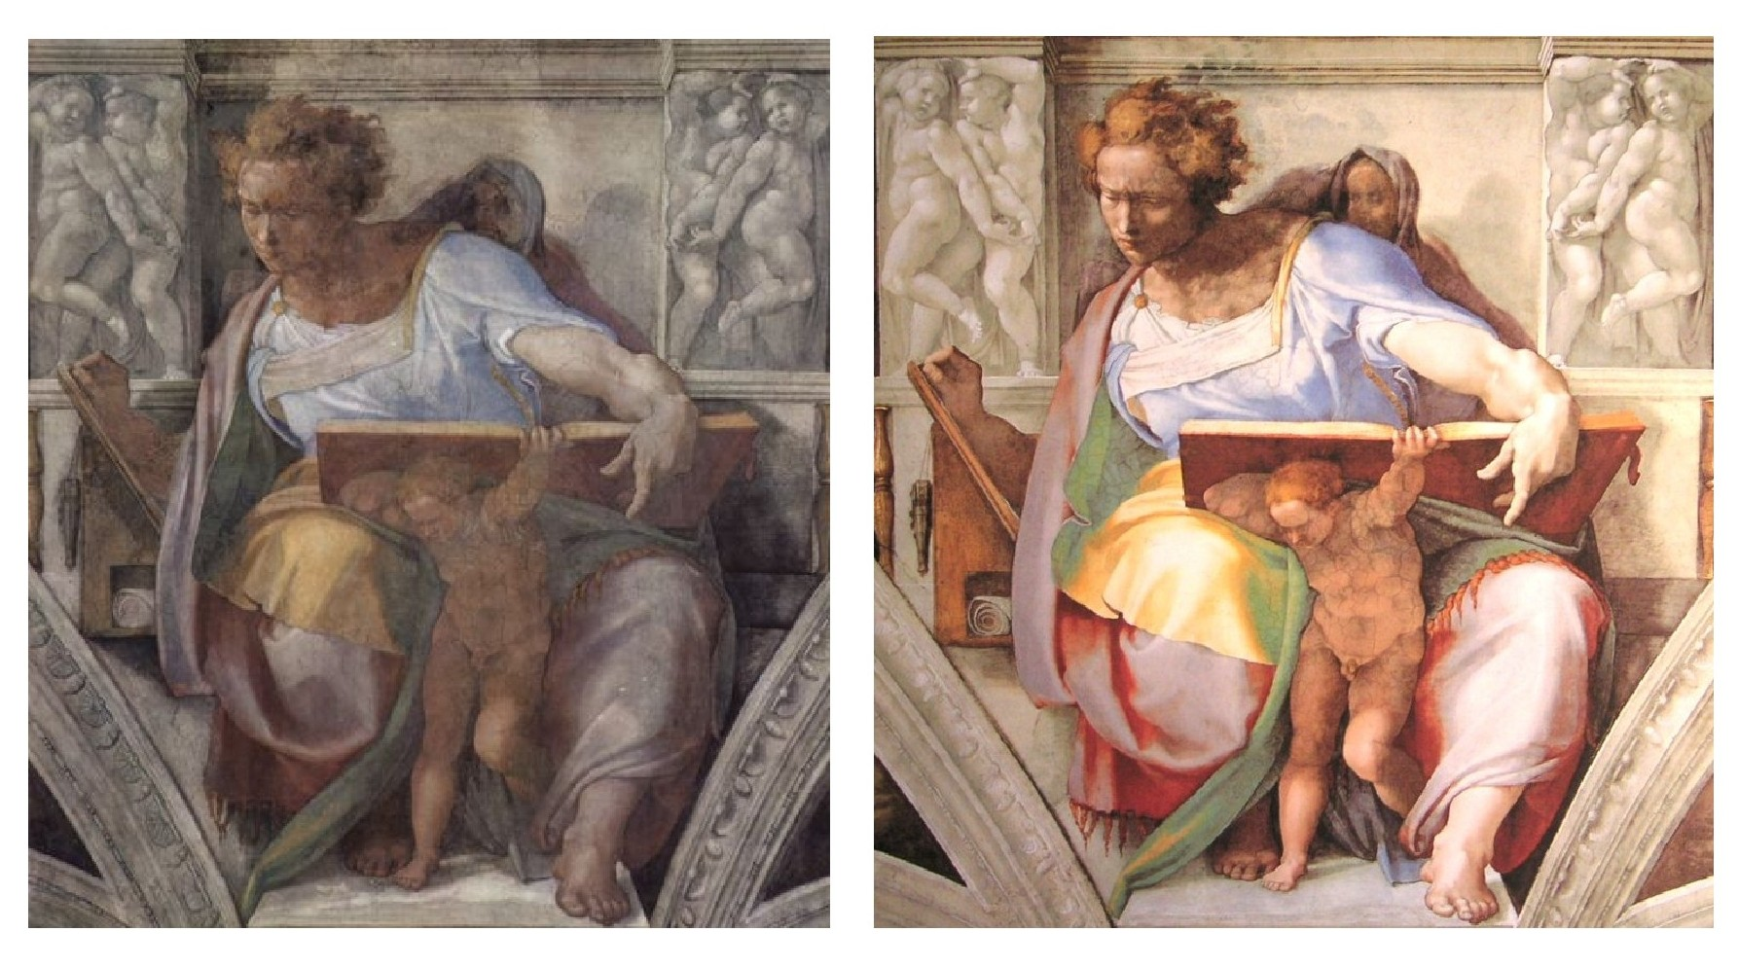
The Prophet Daniel –
before and after restoration

Slide 10
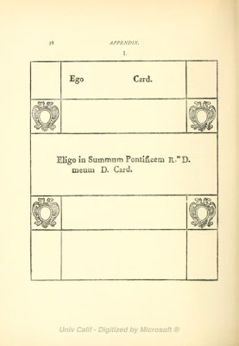
The voting begins…
Each vote requires a new ballot and voting continues until a 2/3 + 1 majority is reached.

Slide 11
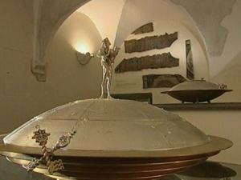
This image made from video released by Vatican TV shows a bronze-rimmed urn with a statue of the good shepherd on it, which will be used to gather together the cardinals votes to elect a new pontiff. Previously, cardinals placed their ballots in a chalice. The actual voting occurs in the Sistine Chapel. (AP Photo/Vatican TV)

Slide 12
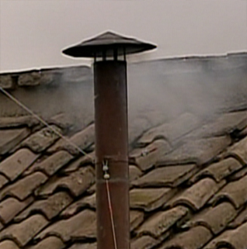
After each vote, the ballots are burned…
Black smoke –
not yet!
White smoke –
We have a Pope!

Slide 13
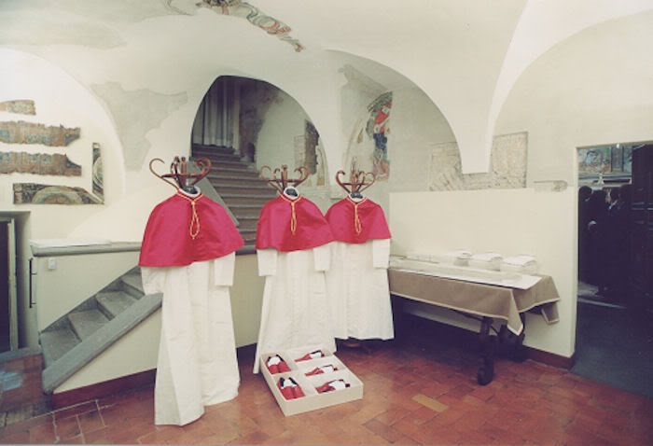
After the new Pope has accepted the position, he goes to the “Room of Tears” a small room next to the Sistine Chapel where he will dress in the new clothing provided there, and take some time to reflect on this great moment.
Tailors will have provided several sizes of clothing and red shoes because they do not know who will be elected!

Slide 14
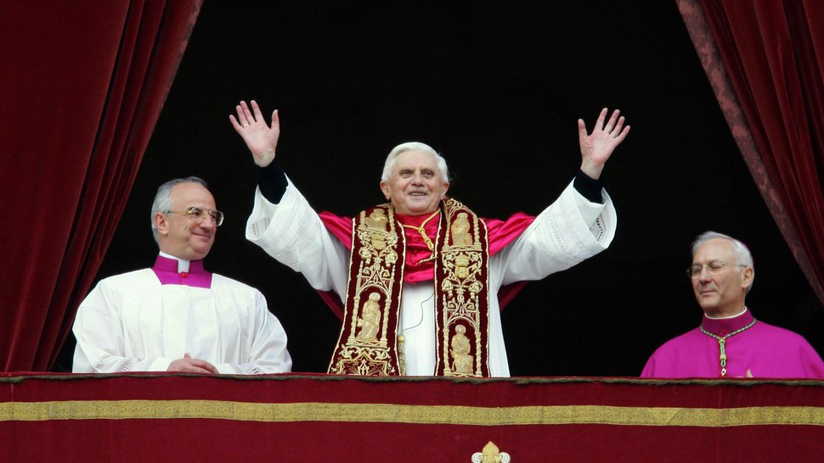
It is announced from the main balcony of St. Peter’s Basilica “Habemus Papam” (We have a Pope!) and the new Pope says a few words and gives his first papal blessing.

Slide 15
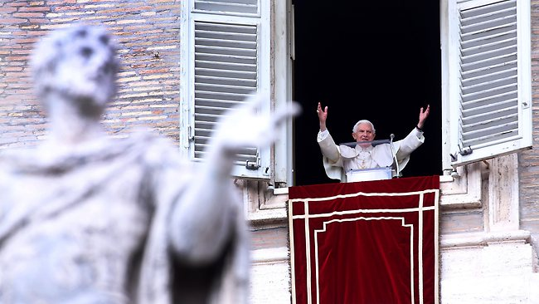
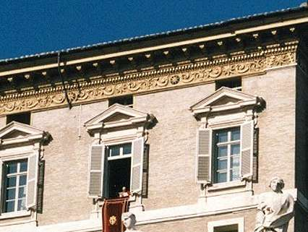
www.heraldsun.com.au
The Pope’s Window will become a much loved place – each week the Pope will speak to the pilgrims gathered in St. Peter’s Square.

Slide 16
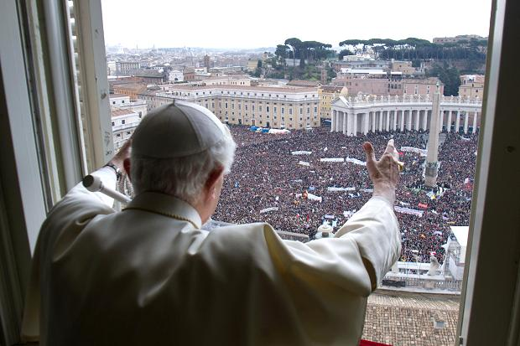
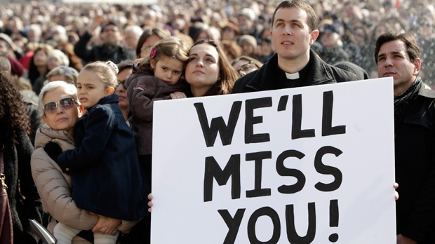
www.thetimes.co.uk
www.cp24.com

