Slide 1
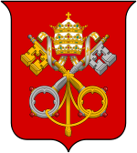
Conclave 2013
The Contenders
While we could all be surprised by the nomination of a lesser known Catholic male, these cardinals are a few of those currently considered the most likely candidates.
Wall Street Journal: www.online.wsj.com

Slide 2
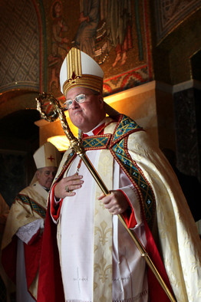
Cardinal Timothy Dolan
United States
Born: Feb. 6, 1950
Age: 63
Cardinal Dolan, who is archbishop of New York and president of the U.S. Conference of Catholic Bishops, was installed as the head of the church in New York in 2009 by Pope Benedict, and appointed by him to the College of Cardinals in January 2012.
A native of Shrewsbury, Mo., he was ordained to the priesthood in 1976. Before coming to New York, he served as archbishop of Milwaukee for almost seven years.
In recent months, Cardinal Dolan has been closely tied to the Catholic Church’s opposition to sections of the U.S. government’s health-care overhaul requiring mandatory insurance coverage of contraception, including the morning-after pill. Some Catholic-owned businesses and high-profile Catholic universities consider the morning-after pill to be a form of abortion and, therefore, counter to the church’s teachings.
Robert Cohen/St. Louis Post-Dispatch/Associated Press
Wall Street Journal: www.online.wsj.com

Slide 3
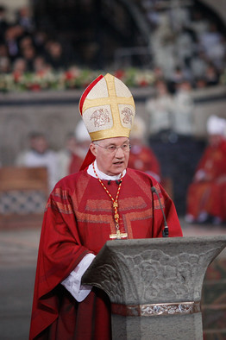
Cardinal Marc Ouellet
Canada
Born: June 8, 1944
Age: 68
Born in a small town in rural, French-speaking Quebec, Cardinal Ouellet was ordained to the priesthood in his home parish in Amos, Quebec, in May 1968. He has spent much of his career as a teacher in Quebec and Rome, and as a rector in seminaries. Pope John Paul II ordained Cardinal Ouellet a bishop in March 2001. He was elevated to archbishop of Quebec in November 2002.
In 2010, Pope Benedict appointed Cardinal Ouellet to head the Congregation of Bishops. The influential office vets bishop appointments, giving the Canadian cardinal a critical role in shaping the next generation of leaders who oversee local dioceses.
The decision was seen as significant at the time because it was made as the church struggled with intense scrutiny over the failure of some bishops to report alleged sexual abuse to civil authorities. The role placed Cardinal Ouellet in a position to shape how the church would require bishops and other top church officials to better monitor priests under their supervision.
Ralph Orlowski/Getty Images
Wall Street Journal: www.online.wsj.com

Slide 4
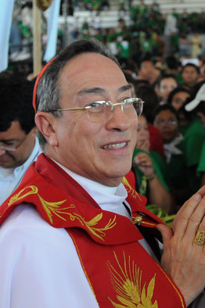
Cardinal Óscar Andrés Rodríguez Maradiaga
Honduras
Born: Dec. 29, 1942
Age: 70
Cardinal Rodríguez Maradiaga is a native of Tegucigalpa, Honduras. A member of the Salesian order since 1961, he was ordained a priest in 1970 in Guatemala. He was elevated to bishop in 1978, has been archbishop of Tegucigalpa since 1993 and was named a cardinal in 2001, becoming the first cardinal from Honduras.
He is president of Caritas Internationalis, a conference of Catholic organizations working around the world to respond to humanitarian emergencies and promote development. From 1995 to 1999, he was president of the Conference of Latin American Bishops. He is the founder of the Catholic University of Honduras.
Cardinal Rodríguez has been a critic of income inequality in Latin America and a strong advocate for forgiveness of third-world debt. But he has also criticized Venezuela’s populist President Hugo Chávez and waded into political controversies at home. In 2009, after then-President Manuel Zelaya, a populist, was forcibly removed from Honduras by soldiers, Cardinal Rodríguez supported the army’s move, arguing that Mr. Zelaya was trampling the constitution.
He is also an expert on sacred music and plays the clarinet.
Orlando Sierra/AFP/Getty Images
Wall Street Journal: www.online.wsj.com

Slide 5
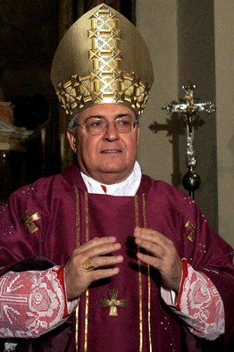
Cardinal Leonardo Sandri
Argentina
Born: Nov. 18, 1943
Age: 69
Born in Buenos Aires, Cardinal Sandri was ordained in his hometown in 1967 and joined the Holy See for diplomatic service in 1974.
He was ordained a cardinal in 2007, and earlier that same year he was appointed prefect of the Congregation for the Oriental Churches, the group that handles relationships with the Eastern Catholic Churches -- those in northern Africa such as in Egypt and the Sinai Peninsula, Eastern European countries such as Hungary and Bulgaria and those in the Middle East, such as Syria and Jordan.
Cardinal Sandri drew the global spotlight in 2005, when he was an archbishop and Pope John Paul II’s chief of staff, a job he took on in 2000. In the final weeks of Pope John Paul’s life, he became the dying pontiff’s public voice, and it was he who announced to the world the news of the pope’s death, in St. Peter’s Square on April 2, 2005. On the Sunday after Pope John Paul’s death, Archbishop Sandri read the traditional Sunday noontime prayer to the crowds gathered in St. Peter’s Square.
Gregorio Borgia/Associated Press
Wall Street Journal: www.online.wsj.com

Slide 6
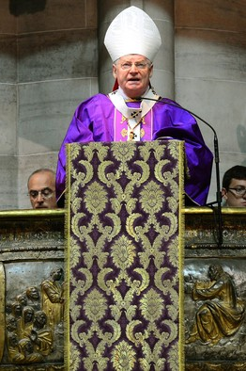
Cardinal Angelo Scola
Italy
Born: Nov. 7, 1941
Age: 71
Cardinal Scola, the patriarch of Venice since 2002 and a cardinal since 2003, is considered to be an open-minded conservative.
The son of a truck driver, he was ordained a priest in 1970 and named bishop of Grosseto in 1991. Since 1982 he has taught theological anthropology at the Pontifical Institute John Paul II for Studies on Marriage and the Family, where in 1995 he was named dean. In the same year, he was named rector of the Pontifical Council of the Lateran University in Rome.
He has called for broadening Catholic religious instruction to include issues involving the economic and bioethical challenges facing society. He has also been vocal about the need for the church to find a way to confront the Muslim world and recently launched a publication dedicated to that topic.
Oliver Morin/AFP/Getty Images
Wall Street Journal: www.online.wsj.com

Slide 7
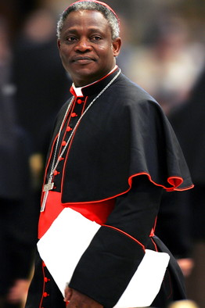
Cardinal Peter Kodwo Appiah Turkson
Ghana
Born: Oct. 11, 1948
Age: 64
The former archbishop of Cape Coast, Ghana, Cardinal Turkson is a native of that country. He studied at the Seminary of St. Anthony-on-Hudson in Rensselaer, N.Y., before being ordained to the priesthood in Ghana in 1975. In 1992 he was elected archbishop of Cape Coast. He was ordained a cardinal in 2003, the first from his country. In October 2009, he was appointed by Benedict to be president of the Pontifical Council for Justice and Peace.
Cardinal Turkson has addressed some of the church's most contentious positions, including its opposition to distributing condoms to curb HIV transmission. In 2007, he stirred controversy by saying the Catholic Church should counsel the faithful on whether condoms were the best option for fighting HIV. In 2010, the Vatican went on to refine its view, saying the use of condoms among homosexuals and heterosexuals was preferable to risking HIV infection.
Max Rossi/Reuter
Seasoned Vatican watchers have long spoken of Cardinal Turkson as the most likely to become the first African pope since Gelasius I in the late fifth century, and only the third African pope in history. But while Gelasius hailed from Africa's Mediterranean, a significant incubator of the early church, Cardinal Turkson comes from the Vatican's newest growth region: Sub-Saharan Africa.
Wall Street Journal: www.online.wsj.com

Slide 8
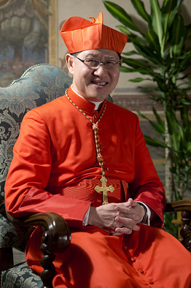
Cardinal Luis Antonio Tagle
Philippines
Born: June 21, 1957
Age: 55
Manila Archbishop Cardinal Tagle is still calling himself a greenhorn after being named a cardinal last October. On Feb. 17, he told a leadership forum in Manila that he was reading up on what is involved in selecting the next pope after Pope Benedict XVI announced his plans to retire. Yet Cardinal Tagle, 55 years old, is attracting growing attention as a dark-horse candidate for the papacy, thanks in large part to his theological conservatism, denouncing government plans to extend the use of contraceptives, and his gifts as a communicator.
Faced with the growing lure of televangelist and charismatic preachers in the Philippines, Cardinal Tagle takes airwaves himself in a regular television show and has developed a reputation as a priest with a common touch. Among other things, he has been known to visit parishioners on a cheap bicycle.
Vatican analysts, however, suggest that Cardinal Tagle’s age might count against him for the papacy. The Roman Catholic Church generally prefers its popes a little older. But the cardinals have surprised observers before. In 1978, 58-year-old Cardinal Karol Josef Wojtyla became Pope John Paul II.
Andrew Medichini/Associated Press
Wall Street Journal: www.online.wsj.com

